Slide 1
ALGORITHM
SIDDHARTHA BANERJEE
RAMAKRISHNA MISSION RESIDENTIAL COLLEGE (AUTONOMOUS), NARENDRAPUR

Slide 2
APPROXIMATION ALGORITHM
1. INTRODUCTION
No NP-hard problem can be solved in polynomial time.
Yet, many NP-hard optimization problems have great practical importance and it is desirable to solve large instances of these problems in a reasonable amount of time.
The best-known algorithms for NP-hard problems have a worst-case complexity that is exponential in the number of inputs.

Slide 3
APPROXIMATION ALGORITHM
1. INTRODUCTION
The use of heuristics in an existing algorithm may enable it to quickly solve a large instance of a problem provided the heuristic works on that instance.
A heuristic, however, does not work equally effectively on all problem instances.
Exponential time algorithms, even coupled with heuristics, still show exponential behavior on some set of inputs.

Slide 4
APPROXIMATION ALGORITHM
1. INTRODUCTION
If we are to produce an algorithm of low polynomial complexity to solve NP-hard optimization problem, then it is necessary to relax the meaning of “solve”.
In this chapter we discuss two relaxations of the meaning of “solve”.
In the first we remove the requirement that the algorithm that solves the optimization problem P must always generate an optimal solution.

Slide 5
APPROXIMATION ALGORITHM
1. INTRODUCTION
This requirements replaced by the requirement that the algorithm for P must always generate a feasible solution with value close to the value of an optimal solution.
A feasible solution with value close to the value of an optimal solution is called an approximate solution.
An approximation algorithm for P is an algorithm that generates approximate solutions for P.

Slide 6
APPROXIMATION ALGORITHM
1. INTRODUCTION
In the second relaxation we look for an algorithm for P that almost always generates optimal solution.
As algorithms with this property are called probabilistically good algorithms.

Slide 7
APPROXIMATION ALGORITHM
1. INTRODUCTION
Let P be a problem such as the knapsack or the traveling salesperson problem.
Let I be an instance of problem P and let F*(I) be the value of an optimal solution.
An approximation algorithm generally produces a feasible solution to I whose value Fʹ(I) is less than (greater than) F*(I) if P is a maximization (minimization) problem.

Slide 8
APPROXIMATION ALGORITHM
1. INTRODUCTION
Several categories of approximation algorithms can be defined.
Let A be an algorithm that generates a feasible solution to every instance I of a problem P.
Let F*(I) be the value of an optimal solution to I and let Fʹ(I) be the value of the feasible solution generated by A.

Slide 9

APPROXIMATION ALGORITHM
INTRODUCTION
ʹ

Slide 10
APPROXIMATION ALGORITHM
INTRODUCTION
ʹ
ʹ

Slide 11
APPROXIMATION ALGORITHM
INTRODUCTION
ʹ
ʹ

Slide 12


APPROXIMATION ALGORITHM
INTRODUCTION

Slide 13
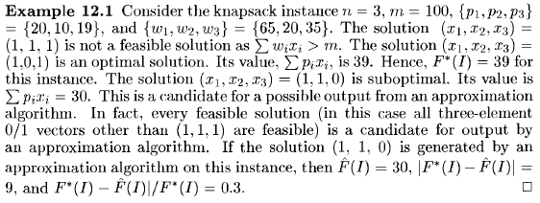
APPROXIMATION ALGORITHM
INTRODUCTION

Slide 14
APPROXIMATION ALGORITHM
INTRODUCTION

Slide 15
APPROXIMATION ALGORITHM
INTRODUCTION

Slide 16
APPROXIMATION ALGORITHM
INTRODUCTION

Slide 17
APPROXIMATION ALGORITHM
INTRODUCTION

Slide 18
APPROXIMATION ALGORITHM
INTRODUCTION

Slide 19
APPROXIMATION ALGORITHM
INTRODUCTION

Slide 20
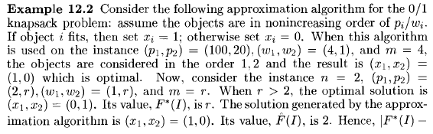
APPROXIMATION ALGORITHM
INTRODUCTION

Slide 21
APPROXIMATION ALGORITHM
INTRODUCTION

Slide 22
APPROXIMATION ALGORITHM
INTRODUCTION

Slide 23
APPROXIMATION ALGORITHM
INTRODUCTION

Slide 24
APPROXIMATION ALGORITHM
INTRODUCTION

Slide 25
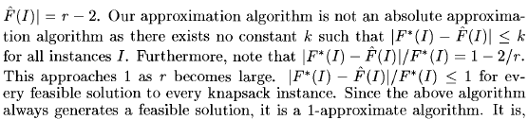
APPROXIMATION ALGORITHM
INTRODUCTION

Slide 26
APPROXIMATION ALGORITHM
INTRODUCTION

Slide 27
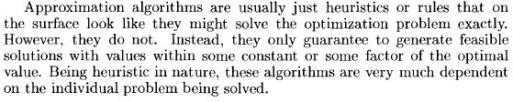
APPROXIMATION ALGORITHM
INTRODUCTION

Slide 28
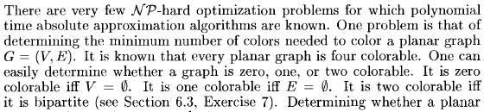
APPROXIMATION ALGORITHM
2. ABSOLUTEAPPROXIMATION
2.1 Planar Graph Coloring

Slide 29
APPROXIMATION ALGORITHM
2. ABSOLUTEAPPROXIMATION
2.1 Planar Graph Coloring

Slide 30
APPROXIMATION ALGORITHM
2. ABSOLUTEAPPROXIMATION
2.1 Planar Graph Coloring

Slide 31

APPROXIMATION ALGORITHM
2. ABSOLUTEAPPROXIMATION
2.1 Planar Graph Coloring

Slide 32
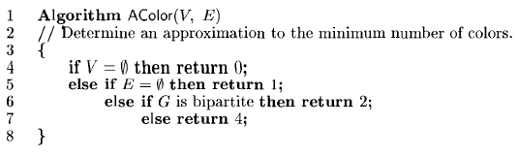
APPROXIMATION ALGORITHM
2. ABSOLUTEAPPROXIMATION
2.1 Planar Graph Coloring

Slide 33
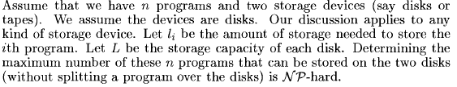
APPROXIMATION ALGORITHM
2. ABSOLUTEAPPROXIMATION
2.1 Maximum Programs Stored Problem

Slide 34
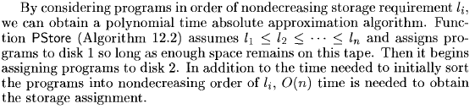
APPROXIMATION ALGORITHM
2. ABSOLUTEAPPROXIMATION
2.1 Maximum Programs Stored Problem

Slide 35
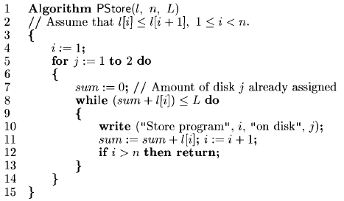
APPROXIMATION ALGORITHM
2. ABSOLUTEAPPROXIMATION
2.1 Maximum Programs Stored Problem

Slide 36

APPROXIMATION ALGORITHM
2. ABSOLUTEAPPROXIMATION
2.1 Maximum Programs Stored Problem

Slide 37

APPROXIMATION ALGORITHM
2. ABSOLUTEAPPROXIMATION
2.1 Maximum Programs Stored Problem

Slide 38
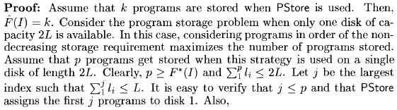
APPROXIMATION ALGORITHM
2. ABSOLUTEAPPROXIMATION
2.1 Maximum Programs Stored Problem

Slide 39
APPROXIMATION ALGORITHM
2. ABSOLUTEAPPROXIMATION
2.1 Maximum Programs Stored Problem

Slide 40
APPROXIMATION ALGORITHM
2. ABSOLUTEAPPROXIMATION
2.1 Maximum Programs Stored Problem

Slide 41
APPROXIMATION ALGORITHM
2. ABSOLUTEAPPROXIMATION
2.1 Maximum Programs Stored Problem

Slide 42
APPROXIMATION ALGORITHM
2. ABSOLUTEAPPROXIMATION
2.1 Maximum Programs Stored Problem

Slide 43
APPROXIMATION ALGORITHM
2. ABSOLUTEAPPROXIMATION
2.1 Maximum Programs Stored Problem

Slide 44
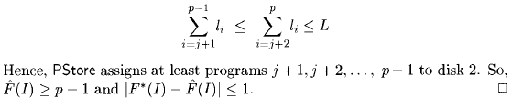
APPROXIMATION ALGORITHM
2. ABSOLUTEAPPROXIMATION
2.1 Maximum Programs Stored Problem

Slide 45
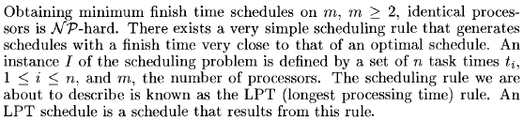
APPROXIMATION ALGORITHM
ϵ - APPROXIMATIONS
3.1 Scheduling Independent Task

Slide 46

APPROXIMATION ALGORITHM
ϵ - APPROXIMATIONS
3.1 Scheduling Independent Task

Slide 47
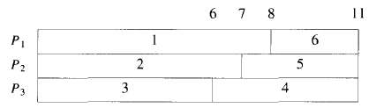
APPROXIMATION ALGORITHM
ϵ - APPROXIMATIONS
3.1 Scheduling Independent Task

Slide 48
APPROXIMATION ALGORITHM
ϵ - APPROXIMATIONS
3.1 Scheduling Independent Task

Slide 49
APPROXIMATION ALGORITHM
ϵ - APPROXIMATIONS
3.1 Scheduling Independent Task

Slide 50
APPROXIMATION ALGORITHM
ϵ - APPROXIMATIONS
3.1 Scheduling Independent Task

Slide 51
APPROXIMATION ALGORITHM
ϵ - APPROXIMATIONS
3.1 Scheduling Independent Task

Slide 52
APPROXIMATION ALGORITHM
ϵ - APPROXIMATIONS
3.1 Scheduling Independent Task

Slide 53
APPROXIMATION ALGORITHM
ϵ - APPROXIMATIONS
3.1 Scheduling Independent Task

Slide 54
APPROXIMATION ALGORITHM
ϵ - APPROXIMATIONS
3.1 Scheduling Independent Task

Slide 55
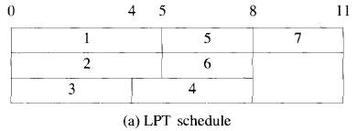
APPROXIMATION ALGORITHM
ϵ - APPROXIMATIONS
3.1 Scheduling Independent Task

Slide 56
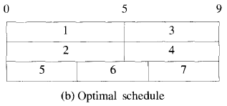
APPROXIMATION ALGORITHM
ϵ - APPROXIMATIONS
3.1 Scheduling Independent Task

Slide 57
APPROXIMATION ALGORITHM
ϵ - APPROXIMATIONS
3.1 Scheduling Independent Task

Slide 58

APPROXIMATION ALGORITHM
ϵ - APPROXIMATIONS
3.1 Scheduling Independent Task

Slide 59
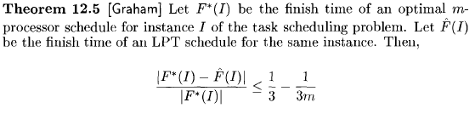
APPROXIMATION ALGORITHM
ϵ - APPROXIMATIONS
3.1 Scheduling Independent Task

Slide 60
APPROXIMATION ALGORITHM
ϵ - APPROXIMATIONS
3.1 Scheduling Independent Task

Slide 61
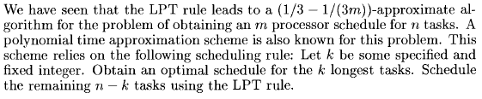
APPROXIMATION ALGORITHM
4. POLYNOMIAL TIME APPROXIMATION
4.1 Scheduling Independent Task

Slide 62
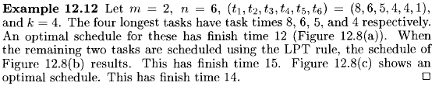
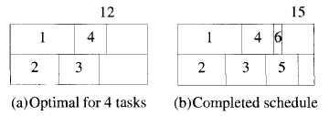
APPROXIMATION ALGORITHM
4. POLYNOMIAL TIME APPROXIMATION
4.1 Scheduling Independent Task

Slide 63
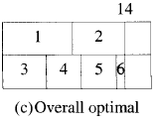
APPROXIMATION ALGORITHM
4. POLYNOMIAL TIME APPROXIMATION
4.1 Scheduling Independent Task

Slide 64
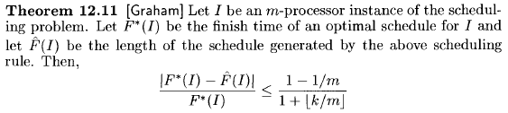
APPROXIMATION ALGORITHM
4. POLYNOMIAL TIME APPROXIMATION
4.1 Scheduling Independent Task

Slide 65
APPROXIMATION ALGORITHM
4. POLYNOMIAL TIME APPROXIMATION
4.1 Scheduling Independent Task

Slide 66
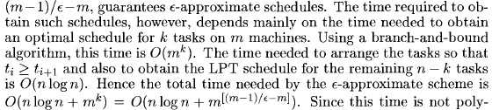
APPROXIMATION ALGORITHM
4. POLYNOMIAL TIME APPROXIMATION
4.1 Scheduling Independent Task

Slide 67
APPROXIMATION ALGORITHM
4. POLYNOMIAL TIME APPROXIMATION
4.1 Scheduling Independent Task

Slide 68
APPROXIMATION ALGORITHM
4. POLYNOMIAL TIME APPROXIMATION
4.1 Scheduling Independent Task

Slide 69

APPROXIMATION ALGORITHM
4. POLYNOMIAL TIME APPROXIMATION
4.1 Scheduling Independent Task

Slide 70
Thank you

